Slide 1

VISUAL CRYPTOGRAPHY and chaos map encryption
Submitted to- BHOOMINATHAN P

Slide 2

单击此处添加标题
Team members
18BCE0420-AGRAWAL KUNAL DHARMENDRA
19BCI0252-REDDY SAI KUNDAN
20BCI0320-SWARIT GUPTA
REVIEW-1

Slide 3

CONTENTS
introduction
Abstract
Problem Statement
tools
Algorithms

Slide 4
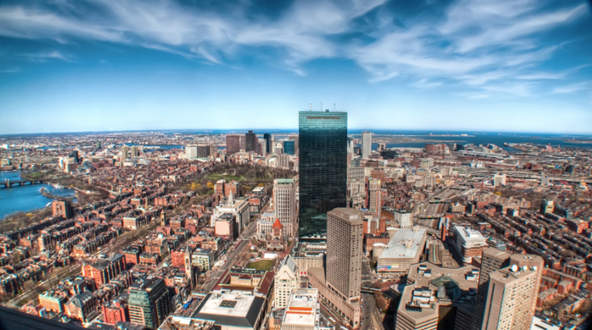

Introduction
The process of encoding a message so that only authorised parties can access it is called encryption.The process of encrypting an image is called image encryption.
we all know image have a very large amount of data.
so there are many types to image encryption are there which are used.
such as Traditional encrypting mechanisms AES and RSA or not to tradistion are Chaos-based cryptography
Most chaotic sequences are calculated iteratively, with the value in each iteration being dependent onthe previous one.
Chaotic systems are a simple sub-sort of nonlinear dynamical systems. They
may contain not very many interfacing parts and these may keep exceptionally simple guidelines,
however, these systems all have an extremely delicate dependence on their underlying conditions

Slide 5

Abstract
Our basic objective in the project is to encrypt images appropriately in social media. As social media is a vast platform, millions of users share their images online and the content is often not secured resulting in large risk of cyber abuse and misuse.
This can also be applied in banks and military bases, where sensitive information is transferred and encryption if data is necessary.
Visual cryptography is such a technique in which an image is ciphered into random images (which cannot be read) when paired with secret images such that when they are paired appropriately under a particular algorithm, the plaintext can be read.
Keywords- Visual Cryptography, Encryption, Decryption, Secret Image,
chaos map.

Slide 6

单击此处添加标题
Problem Statement
The important idea behind Image Cryptography is to encrypt information in the form of images in a secure and flawless way.
The information must be encrypted before it is sent, so that it cannot be illegally read or modified in the middle of transmission.
so we are using a cipher method in which we will create a random image of mode 1 with ramdom pixel of black and white
and encrypting the cipher and secret image using arnold cat.
and send it to reciver wo can decrypt using key and overlaping the secret and ciphered image

Slide 7
TOOLS USED:
IDLE (Integrated Development Environment for Python)
Python 3.4
Python Image Library (PIL)
Pillow (PIL fork) 5.1.0
cv2
matplotlib.pyplot.image
logging

Slide 8
project discription
Load Module.
Input Image.
argparser for easy command.
error handling.
Random Image Key Generation Algorithm a secret image (like a random otp) using a random bit changing .(visual cryptography)
encryption using secret image.
arnold cat map encryption
decryption with symmetric key.
Ciphered and Key Image Alignment (Decryption).
display.

Slide 9
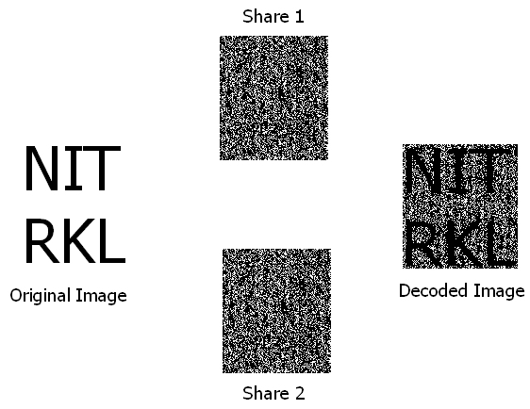

Slide 10
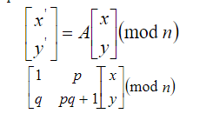
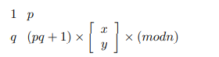
Arnold cat map formula

Slide 11
Body diagram for encryption-code
commmand
check argprace
if secret
count process
true
false
if =0
throw no input
if = 1
show info
if =2 PROCESS
secret image and message input
create secret image
create cipher-image
input message image

Slide 12
Body diagram for decryption-code
commmand
display
decryption
cipher image
secret image
secret image
message image(after decryption)

Slide 13
Body diagram for Arnold's cat map-code
RUN
download image
key
Arnold cat transform
encryption
encrypt image
decryption
decrypt image

Slide 14
refrence
https://www.researchgate.net/publication/309463059_Arnold's_Cat_Map_Algorithm_in_Digital_Image_Encryption
https://en.wikipedia.org/wiki/Visual_cryptography#:~:text=Visual%20cryptography%20is%20a%20cryptographic,appears%20as%20a%20visual%20image.&text=But%20if%20one%20of%20the,can%20be%20increased%20to%20100%25.
https://www.cs.cmu.edu/~efros/courses/LBMV07/Papers/tu-ijcv-05.pdf
https://www.sciencedirect.com/science/article/abs/pii/S0167865505002734

Slide 15
THANK YOU

